Slide 1








Slide 2

Let’s talk about Movies!!
Lights!
Camera!
Action!
This Photo by Unknown Author is licensed under CC BY-SA-NC

Slide 3

About me:
My name is Nisha Kumari. I am from Hyderabad.
I completed my graduation in Pharmaceutical science(M.pharm,2021) from Sri Venkateshwara college of Pharmacy.
I am currently working as a Claims Associate in Optum Global Solutions.
By learning data science I want to transform and grow my career successfully and financially. I am always keen to learn new things and as a fresher I believe I could learn and gain knowledge from basics by being a part of Innomatics.

Slide 4

Domain selection:
IMDB Website
Response – 200
Perfect to extract Data

Slide 5
Exploring the Dataset:
In dataset we can see:
Movie titles
Director
Ratings
Gross of movies
Different Genre’s
Votes given
Certificates
Years

Slide 6
Problem Statement
In this data we are going to analyze and identify the most popular movies with respect to there Ratings and Revenue.

Slide 7
Tools used for this graph
Pandas
NumPy
Matplotlib
Excel
Seaborn
Beautiful soup in web scraping

Slide 8


Collection and Cleaning of Data
After importing all the libraries we scrapped the data from ‘www.imdb.com’ website.
To find all the details we can the below Tag and Class name

Slide 9
Collection and Cleaning of Data
After collecting all the columns which are required we filled the null values and converted the datatypes for numerical values to float and int.
Then exported the data into different format like CVS and excel files.

Slide 10
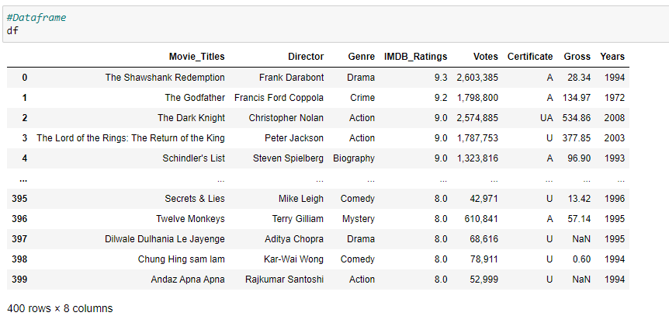

Final Data frame

Slide 11
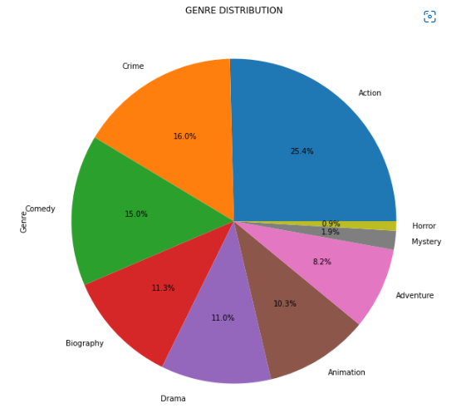

Distribution of Genre
This distribution shows that the top 3 highest percentage of genre was Action(25.4%),Crime(16.0%),Comedy(15.0%) and the least count is for Horror movies(0.9%)

Slide 12
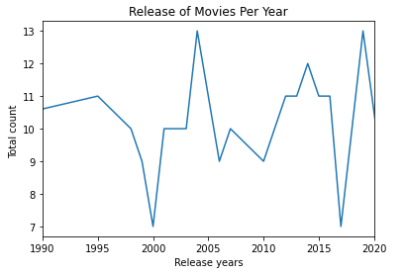

Count of movies released form 1990-2020
Highest number of movies was released or produced was 13 in the year of 2004 and 2019

Slide 13
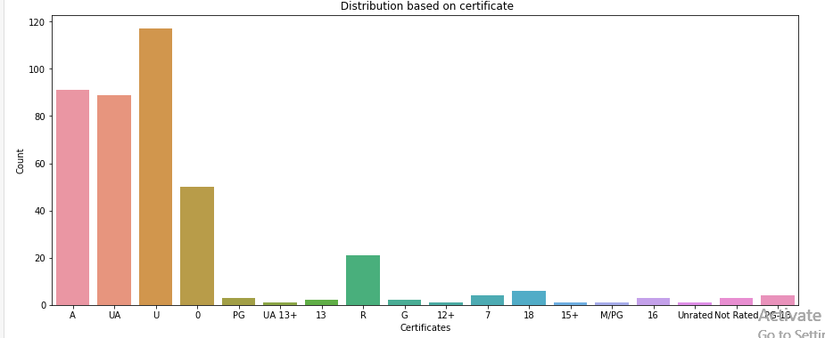

Distribution of Movies based on certificate
From the below plot we can see that the U rated movies are highest in number and also there are large number of U rated movies

Slide 14
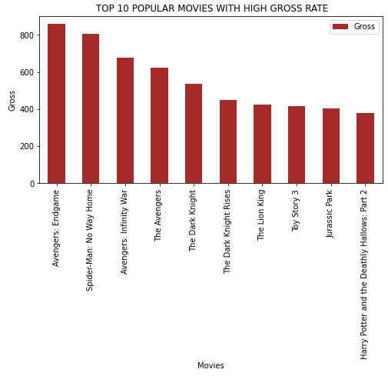

TOP 10 POPULAR MOVIES WITH HIGH GROSS
From the top 10 popular movies the highest revenue movies was Avengers: Endgame

Slide 15
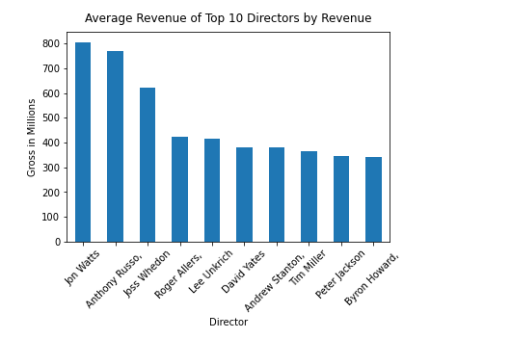

TOP 10 DIRECTORS WITH HIGH GROSS
Below plot shows us the to 10 directors with highest gross and the director with highest revenue was Jon watts followed by Anthony Russo and Joss Wheldon

Slide 16
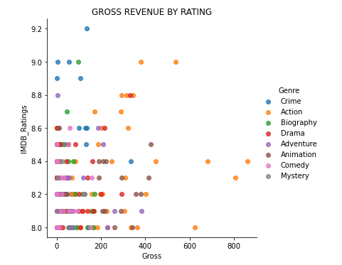

GENRES THAT BRING HIGHER REVENUE AND HIGHER RATING FOR A MOVIE
From below plot we can see that there is a positive correlation between ratings and gross and the genre with highest value is for Crime, Action and Biography

Slide 17
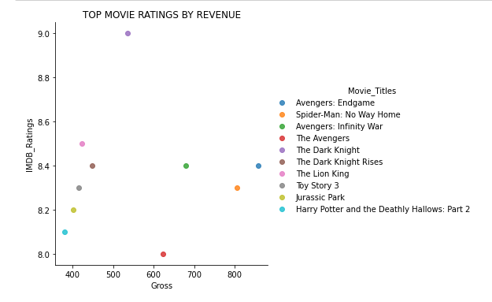

TOP MOVIES WITH HIGH RATINGS AND HIGH REVENUE
Below plot shows us the top 10 movies with high ratings and revenue and from all the movies Avengers: Endgame has the highest value for both.

Slide 18

CONCLUSION:
From all the above analysis we can see that the highest revenue and highest rated movie was Avengers: Endgame with ratings 8.4 and gross 858.37 millions followed by Spiderman:Noway home with ratings 8.3 and gross 804.75.
The most famous and highest revenue director was Jon Watts with revenue of 804.75 millions and the second highest director was Anthony Russo with gross of 768.595 millions.
We can also see that the highest amount of movies were produced in the year of 2004 and 2019 and the count for the movies were 13 for both the years.
Genre such as Drama(8.2), Crime(8.3) and Comedy(8.17) has high revenue and ratings and was produced in large number when compared to other genre.

Slide 19

Thank you!!
for your attention
Any Questions??

Slide 20


